Slide 1
Close Reading
Talking with the Text: Day 1 vs.Day 2: Annotation

Slide 2
Introduction
Close reading is an extensive topic to cover – especially when you add the plethora of terminology that goes along with it!
However – “Latin-ated” language (fancy, shmancy terms to impress your friends with ☺ ) does not need to be mastered before you are able to accomplish this task.
So then what is it?
Close reading is looking, closely …
…Duh?
Yes! But looking closely takes time, effort, and thought concerning a variety of factors at once.
It is a process of entering into a conversation with a text’s multiple facets – that is, becoming a reader who is critical of the words in front of him/her!

Slide 3
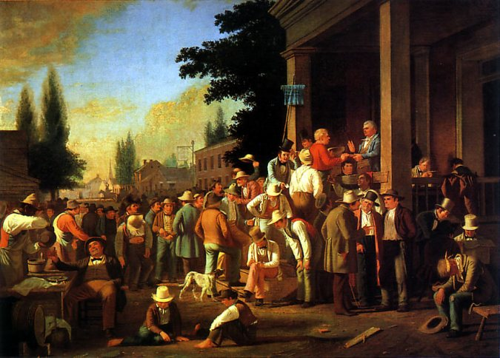
“County Election” George Kaleb Bingham 1852

Slide 5
Talking with the Text!
Hello?
“Effective close reading requires active reading, an exchange between the reader and the text that eventually reveals layers of meaning”
(Shea, Scanlon, Aufses 44).
In order to become an effective close reader you must:
Read the text more than once!
Ask questions of the text – “interrogate” it!
Ask yourself questions as you read
Analyze the syntax of the piece
Analyze the diction that is utilized

Slide 6
Day 1 vs. Day 2
Readings
Day #1
What happened? Who was there? When did it take place? What was said? Where did it take place? What was the general mood of the passage?
Day #2
How and why did it happen? How is it organized? (syntax) What does it look like? Why? What is the tone? What type of diction is used? Are there prominent strategies that the author uses in his/her writing?

Slide 7
Day 1 vs. Day 2 Practice
16 April 1963
My Dear Fellow Clergymen:
While confined here in the Birmingham city jail, I came across your recent statement calling my present activities "unwise and untimely." Seldom do I pause to answer criticism of my work and ideas. If I sought to answer all the criticisms that cross my desk, my secretaries would have little time for anything other than such correspondence in the course of the day, and I would have no time for constructive work. But since I feel that you are men of genuine good will and that your criticisms are sincerely set forth, I want to try to answer your statement in what I hope will be patient and reasonable terms.
I think I should indicate why I am here in Birmingham, since you have been influenced by the view which argues against "outsiders coming in." I have the honor of serving as president of the Southern Christian Leadership Conference, an organization operating in every southern state, with headquarters in Atlanta, Georgia. We have some eighty five affiliated organizations across the South, and one of them is the Alabama Christian Movement for Human Rights. Frequently we share staff, educational and financial resources with our affiliates. Several months ago the affiliate here in Birmingham asked us to be on call to engage in a nonviolent direct action program if such were deemed necessary. We readily consented, and when the hour came we lived up to our promise. So I, along with several members of my staff, am here because I was invited here. I am here because I have organizational ties here.
But more basically, I am in Birmingham because injustice is here. Just as the prophets of the eighth century B.C. left their villages and carried their "thus saith the Lord" far beyond the boundaries of their home towns, and just as the Apostle Paul left his village of Tarsus and carried the gospel of Jesus Christ to the far corners of the Greco Roman world, so am I compelled to carry the gospel of freedom beyond my own home town. Like Paul, I must constantly respond to the Macedonian call for aid.

Slide 8
What to Look for…
When analyzing:
Syntax (arrangement of words) | Diction (choice of words)
Order of parts in a sentence Normal (subject–verb-object) Abnormal (any pattern other than above) What types of sentence patterns are there – cumulative, periodic, etc. Sentence structure Simple, complex, compound, long, short, mixed Transitions and connections within and between paragraphs | What type of language is used: formal, informal, colloquial, dialect, slang, etc. Figurative language: metaphors, similes, personification, hyperbole. Non-literal use of specific words or phrases. Words that have an emotional connotation (“pack a punch”) Words that draw your attention, trip you up, enforce a point previously made, etc.

Slide 9
Give it a try!
Read passage on pg. 48 by Ralph Ellison
come up with four specific observations about syntax and diction (2 per)

Slide 11
annotation
The permanent record of an intellectual and interactive discussion with a text done by a reader or audience.
What this complex definition means is that reading is not a “viewer only” action; reading is not placid or unthinking.
You are not merely allowing your eyes to wander over the words. Rather, you are having an intellectual conversation with it:
asking it questions, observing and commenting on its moves and techniques, forming a record of what is said, both literally and not, etc.

Slide 12
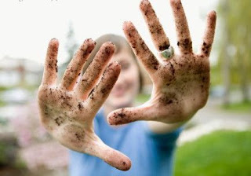
“Get your elbows (or hands) dirty!”
Annotation = reading with a pen, pencil or highlighter in hand, always!
Let’s take a look at some different ideas about how to go about annotating a text – or “ getting your elbows dirty” in the text.
“A Reader’s Guide to Annotation”
Brassil’s “Annotating a Text”

